Slide 1
Capstone Project – Movie Rental Analysis
By:- Niroopa ray
Da(batch-4)

Slide 2


OVERVIEW OF MOVIE RENTAL ANALYSIS
Objective: The objective of this project is to create a comprehensive Power BI dashboard utilizing the Sakila Movie Rental Database. The dashboard aims to provide valuable insights to understand customer behavior and preferences, optimize film inventory management, evaluate staff performance and store operations, enabling data-driven decision making and strategic planning.
Analysis Scope: The analysis will delve into different facets of the movie rental process, covering areas such as film rentals, film performance, store operations. It will entail historical rental data, actor and genre contributions, and store performance metrics.. The dataset will include comprehensive information from various movie rental stores and the rental history of diverse films.

Slide 3


Goal: The primary goal of this Power BI dashboard is to provide a comprehensive overview of the movie rental company's operations. It aims to offer actionable insights to optimize film rentals, enhance collaboration with actors and genres, improve store distribution strategies, and identify opportunities for growth and efficiency in the competitive movie rental market.
Report & Presentation: The final deliverable will consist of a detailed report describing the data sources, data modeling methodologies, and data cleansing processes used in creating the Power BI dashboard. The report will also include a step-by-step guide on how to interpret the insights and use the dashboard for decision-making. The presentation will showcase the key findings, visualizations, and actionable recommendations derived from the dashboard's analysis.
The Power BI dashboard, along with the report and presentation, will serve as a powerful tool for the rental company's stakeholders. It will empower them to make informed decisions, optimize rental sales strategies, and enhance the overall business performance in the competitive publishing landscape

Slide 4
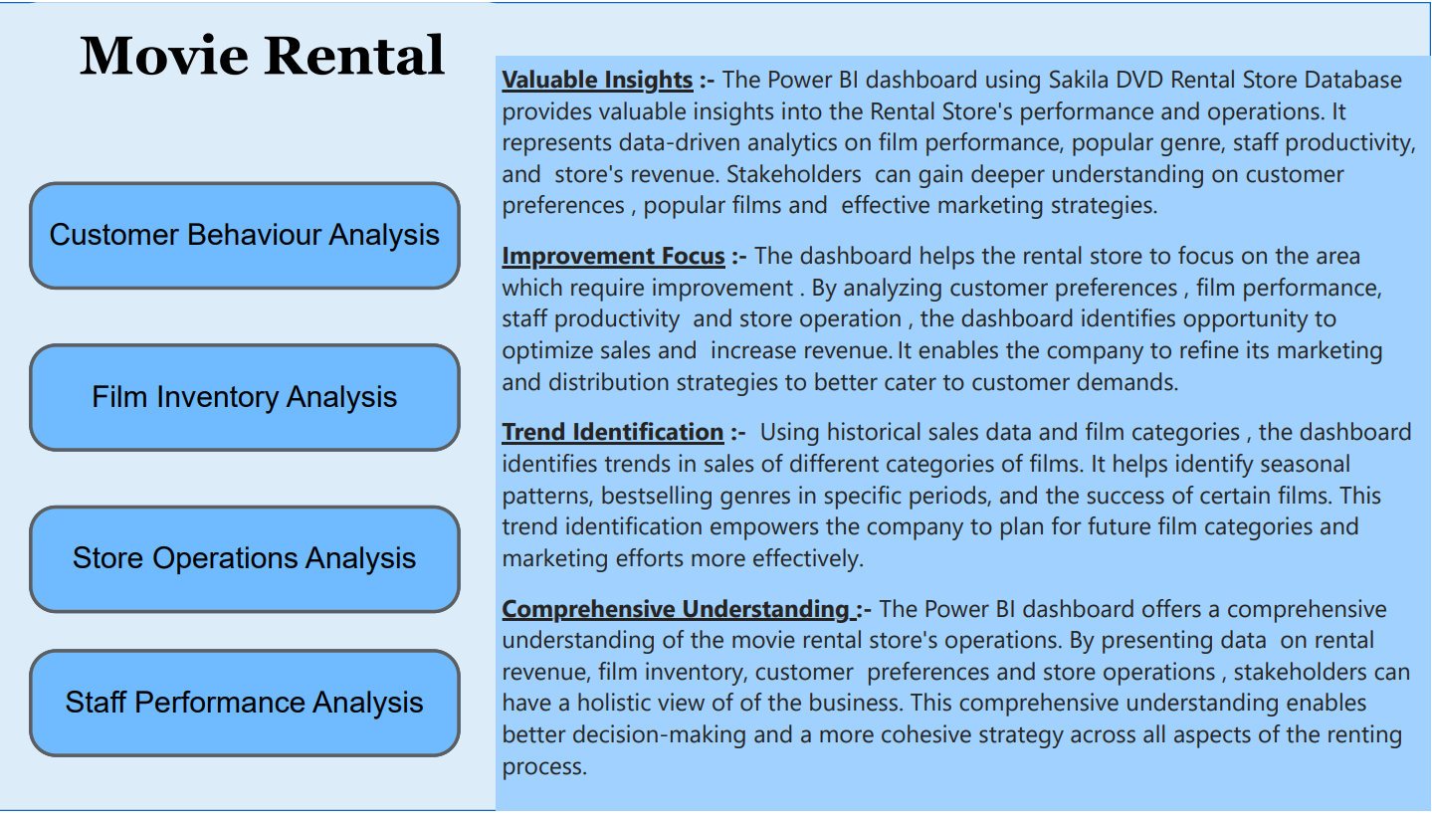

Slide 5
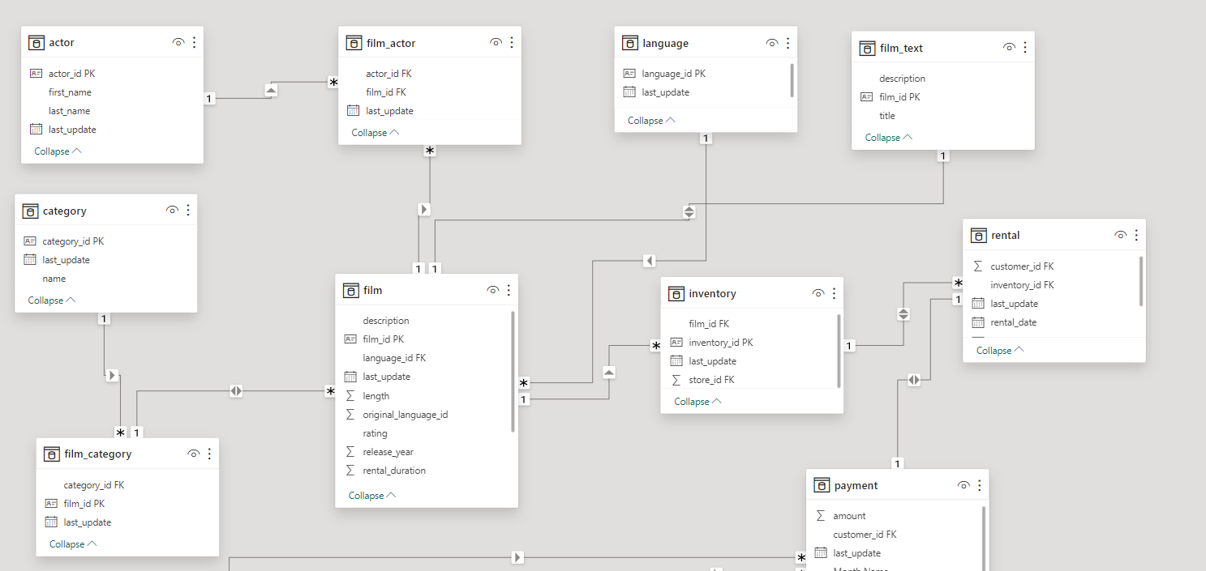
E-R DIAGRAM OF MOVIE RENTAL DATASET

Slide 6
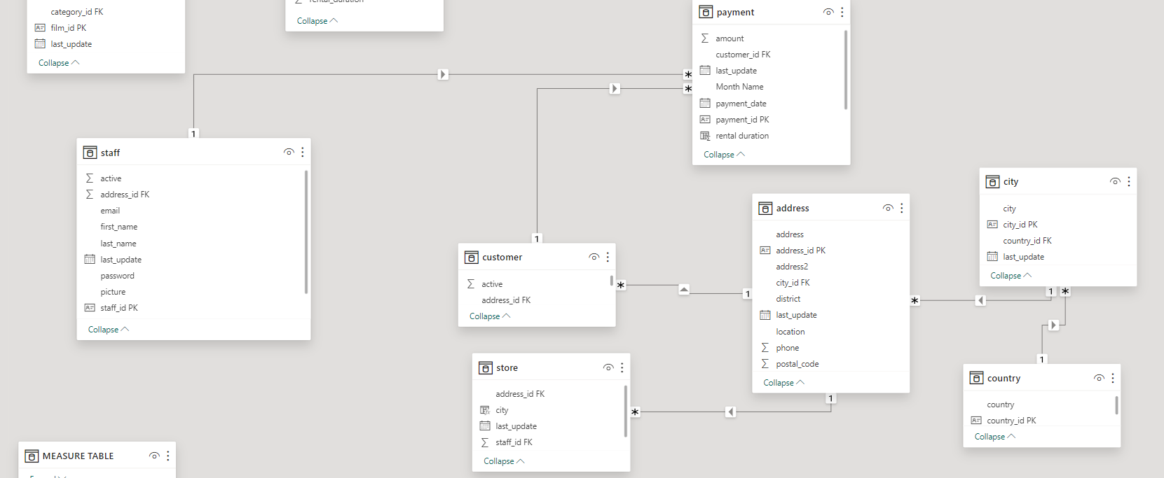

Slide 7
POWER BI PROBLEM STATEMENTS

Slide 8
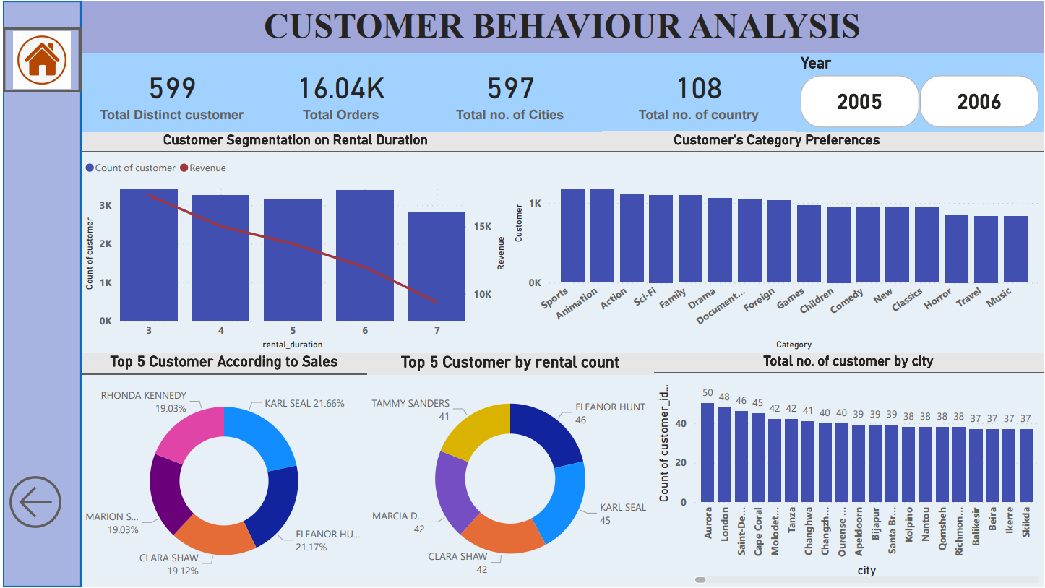

Slide 9
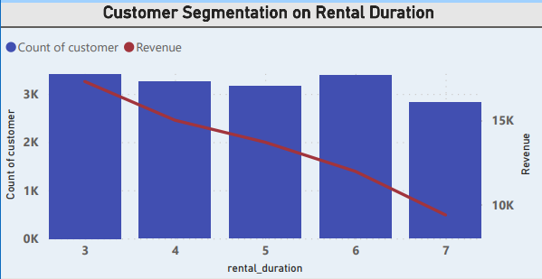
Which customer segments generate the highest sales?
Customers with a rental duration of 3 contribute the highest sales, while those with a duration of 7 generate the least sales among the segmented groups.

Slide 10
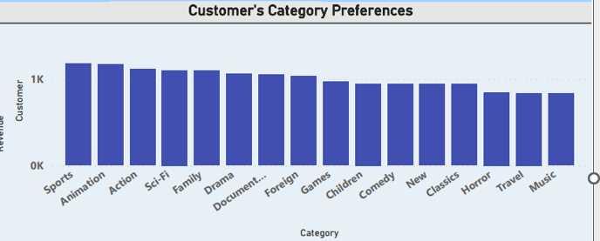
Which film category enjoys the highest popularity among customers?
The analysis reveals that the sports category stands out as the most popular, closely followed by animation and action genres, while music, travel, and horror categories appear to be less popular among customers.

Slide 11
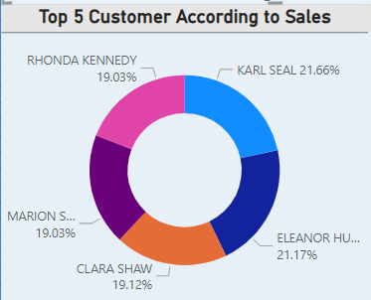
Find top 5 customer according to sales?
The top 5 customers with the highest sales are led by Karl Seal, followed by Eleanor Hunt, Clara Shaw, Marion Synder, and Rhonda Kennedy.

Slide 12
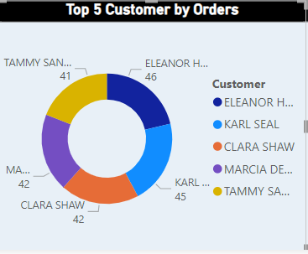
Find customers who had made maximum orders?
The top 5 customers with the highest number of orders are led by Eleanor Hunt with 46 orders , followed by Karl Seal with 45, Clara Shaw & Marcia Dean with 42 and Tammy Sanders with 41 orders.

Slide 13
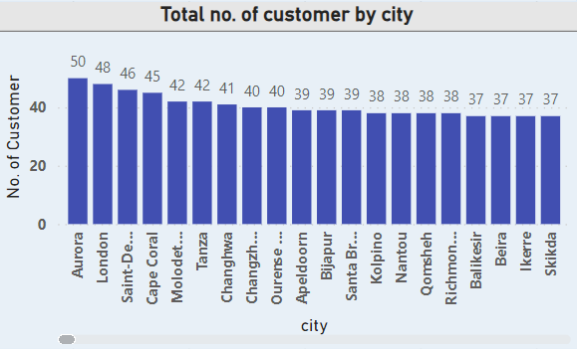
What is the distribution of customers across different cities?
The distribution of customers across different cities indicates that there are 597 unique cities in the dataset. Among these, Aurora has the highest number of customers with 50, followed by London with 48, and Saint-denis with 46 customers. On the other hand, cities like Bydgoszcz, Basel, and Enshi have the least number of customers, each having 12, 14, and 14 customers, respectively. This demonstrates the varied customer presence across different cities.

Slide 14
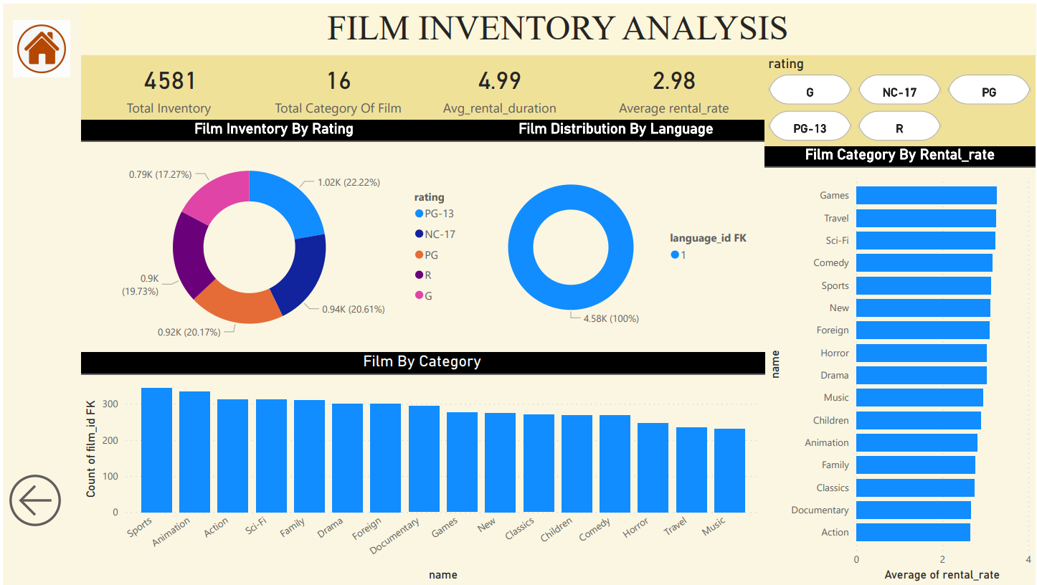

Slide 15
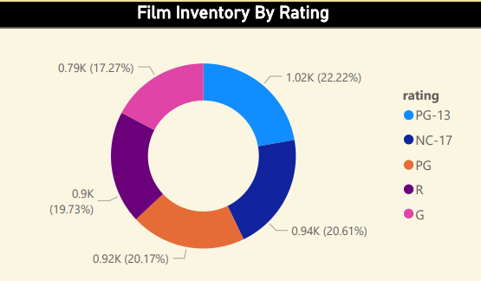
How does the inventory vary by film rating?
The inventory distribution by film rating shows that the highest percentage of films belong to the PG-13 category at 22.22%, followed by NC-17 at 20.61%, PG at 20.17%, R at 19.73%, and G at 17.27%.

Slide 16
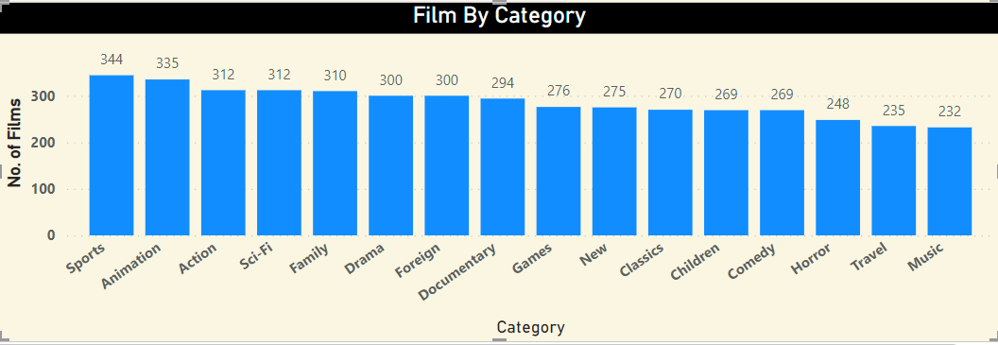
What is the breakdown of film categories in the inventory?
The inventory breakdown highlights a diverse collection of films, with Sports leading at 344 films, closely followed by Animation at 335. The inventory reflects a well-rounded offering, with genres such as Family, Drama & Foreign, Documentary, and Games contributing significantly. The presence of New releases and Classics suggests a balance between fresh content and enduring favorites, ensuring a varied and appealing selection for customers

Slide 17
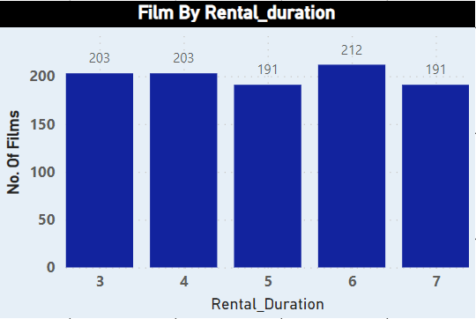
What is the distribution of films by rental duration?
There are a total of 203 films with rental durations 3 and 4, 191 films with rental durations 5 and 7, and 212 films with a rental duration of 6.

Slide 18
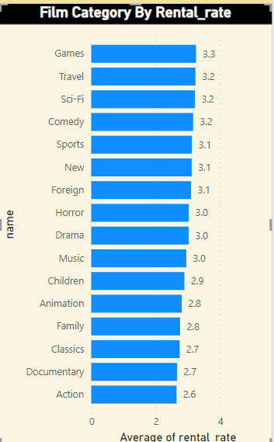
Which film categories have the highest rental rates?
Out of the 17 film categories, the ones with the highest rental rates are Games with 3.3, followed by Travel, Sci-Fi, and Comedy with 3.2. Additionally, Sports, New, and Foreign categories have a rental rate of 3.1.

Slide 19
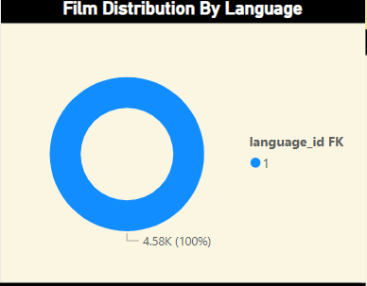
What is the distribution of films by language?
The distribution of films by language reveals that there is only one language in the dataset, identified by language_id -1, and it corresponds to English.

Slide 20
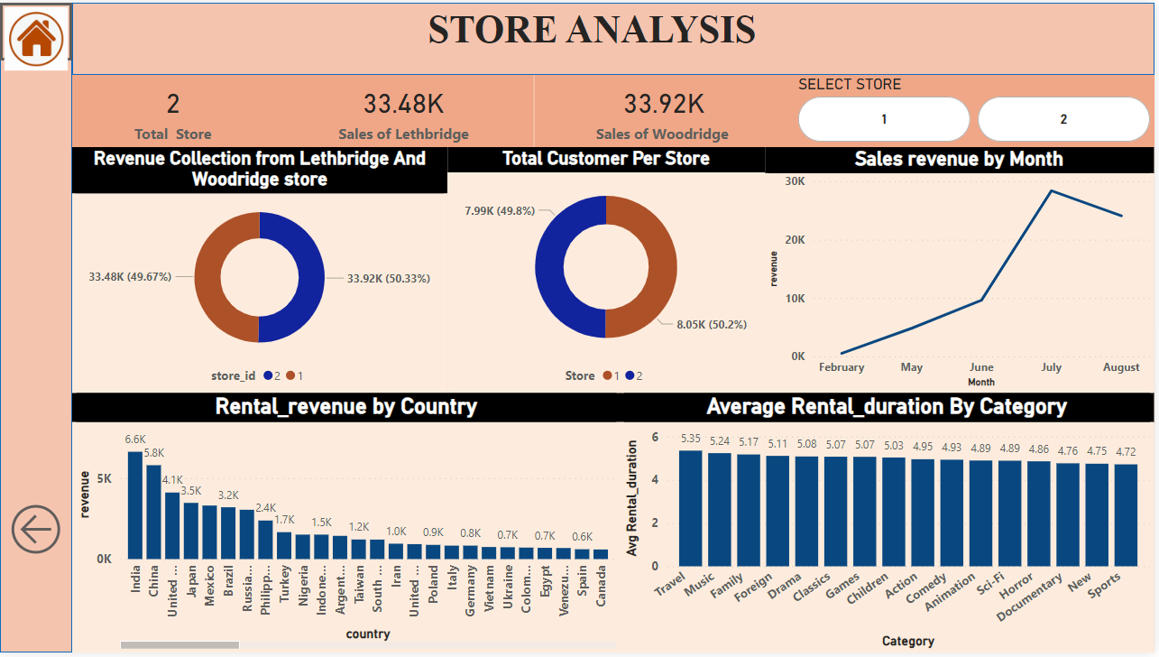


Slide 21
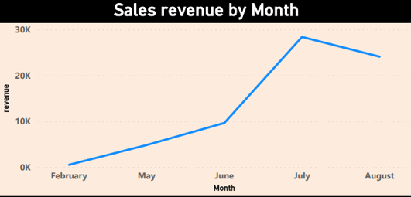
How does the sales revenue vary by month?
The revenue shows a consistent upward trend from February to June .
However, there is a sharp and significant increase in revenue between June and July
Following July, there is a decline in sales, indicating a decrease in revenue after the peak observed in July.

Slide 22
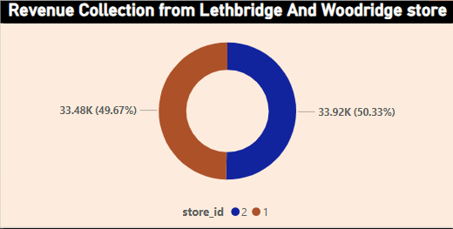
How does the store performance vary by location?
The store performance varies across locations, with the Lethbridge store generating a revenue collection of 33.48K, while the Woodridge store surpasses it with a higher revenue of 33.92K. This indicates a nuanced performance distinction between the two stores, with Woodridge leading in terms of revenue generation.

Slide 23
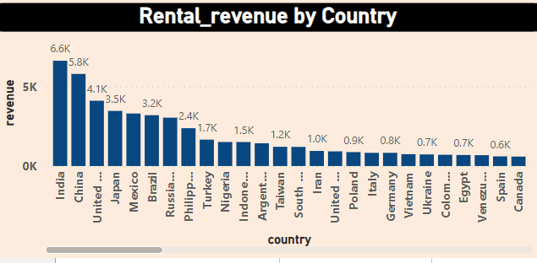
How does the rental revenue vary by country?
The rental revenue varies by country, with India leading with the highest revenue of 6.6K, followed by China with 5.8K, and the United States with 4.1K. On the other hand, Afghanistan and American Samoa have the least rental revenue, both registering 0.1K.

Slide 24
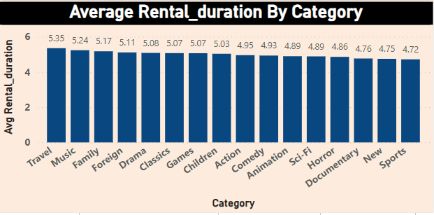
How does the average rental duration vary by film category?
The average rental duration varies across different film categories. Films in the Travel category have the highest average rental duration at 5.35, followed by Music at 5.24, Family at 5.17, and Foreign at 5.08. On the other hand, Sports has the lowest average rental duration at 4.72, and New has an average rental duration of 4.75.

Slide 25
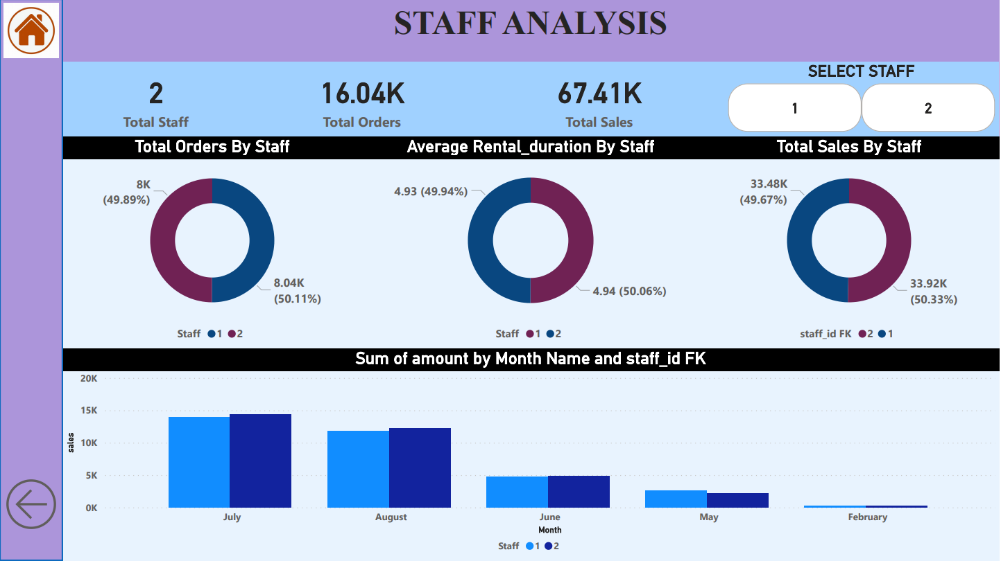

Slide 26
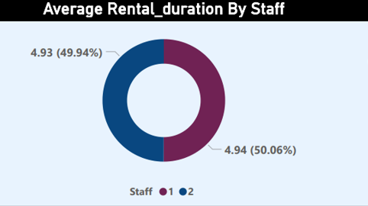
What is the average rental duration by staff member?
The average rental duration is calculated for each staff member, revealing that Staff 1 has an average rental duration of 4.93, while Staff 2's average is slightly higher at 4.94.

Slide 27
EDA PROBLEM STATEMENT

Slide 28
What are the purchasing patterns of new customers versus repeat customers?
In May, there is a significant number of new customers (520) making purchases, indicating a strong influx of new business. However, in June, the number of new customers drops to 60, and there are no new customers added in the subsequent months. On the other hand, the count of repeat customers shows a rising trend from May to June, indicating increasing loyalty. The count of repeat customers remains relatively stable in the subsequent months, with a slight decline in August and a more significant decline in February. This suggests that while new customer acquisition is prominent in May, the focus on retaining and engaging repeat customers becomes crucial in subsequent months.

Slide 29
Which films have the highest rental rates and are most in demand?
The analysis identifies "Bucket Brotherhood" as the most in-demand film with the highest rental rate of $4.99 and 34 rental occurrences. Other top films, such as "Scalawag Duck" and "Goodfellas Salute," also share the same rental rate but vary in rental counts. This information provides insights into the most popular films, assisting in inventory management and strategic decision-making for the movie rental business.

Slide 30
Are there seasonal trends in customer behavior across different locations?
Based on the provided data, there are clear seasonal trends in customer behavior across different store locations. The rental counts show an increase during the summer months (June to August) and a decrease during the winter months (February). This pattern suggests a seasonal influence on customer rental behavior, possibly driven by factors such as holidays, weather, or vacation periods. The data indicates that customers are more active in renting movies during the warmer months and less active during colder periods.

Slide 31
Are certain language films more popular among specific customer segments?
The analysis indicates that the dataset contains films with only one language, which is English. However, due to the limited diversity in language options in the dataset, it is challenging to draw conclusions about certain language films being more popular among specific customer segments. A broader and more varied dataset with multiple language options would be necessary to explore potential preferences among different customer segments based on film language.

Slide 32
How does customer loyalty impact sales revenue over time?
The analysis demonstrates a strong correlation between customer loyalty and sales revenue over time. As the repeat purchase rate increases, so does the revenue. In July 2005, with a 100% repeat purchase rate, the revenue reached its peak at $28,373.89, indicating a direct positive impact of customer loyalty on sales. However, in February 2006, with a lower repeat purchase rate of 15%, the revenue significantly decreased to $514.18, emphasizing the importance of fostering customer loyalty for sustained business growth.

Slide 33
Are certain film categories more popular in specific locations?
The analysis reveals that film category preferences vary by location. In Woodridge, customers show a strong preference for category 15, indicating a specific interest or demand in that genre. Conversely, in Lethbridge, film category 1 emerges as the most popular, suggesting distinct preferences in this location. This information can guide inventory management and marketing strategies tailored to each store's unique audience.

Slide 34
What are the demographics and preferences of the highest-spending customers?
The top-spending customers, such as Karl Seal and Eleanor Hunt, exhibit diverse film category preferences, with category 2 being a common choice. Understanding these preferences enables targeted marketing strategies to enhance customer engagement and satisfaction.
Customer_name | Total_spending | Film_category_preference
Karl Seal | 9970 | 2
Eleanor Hunt | 9961 | 8
Clara Shaw | 8214 | 7
Rhonda Kennedy | 7590 | 10
Marion Synder | 7590 | 2,7,9,15
Marcia Dean | 7374 | 10,9
Wesley Bull | 7104 | 10
Tommy Collazo | 7092 | 8,5
Tim Cary | 6849 | 2
June Carroll | 6424 | 2

Slide 35
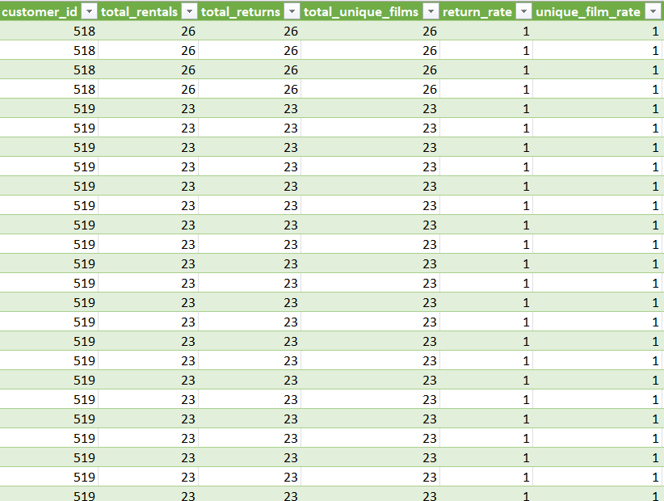
How does the availability of inventory impact customer satisfaction and repeat business?
The data suggests a positive correlation between the availability of inventory and customer satisfaction, as indicated by a unique film rate of 1 for all customers. This implies that customers consistently find the films they are looking for in stock, contributing to their satisfaction. The return rate of 1 further supports the idea that the availability of inventory leads to repeat business, indicating that customers are likely to return for additional rentals. In summary, maintaining sufficient stock appears to enhance customer satisfaction and encourage repeat business.

Slide 36
What are the busiest hours or days for each store location, and how does it impact staffing requirements?
The busiest hours for both Store 1 and Store 2 are at 3 pm in the afternoon. This information is crucial for staffing requirements, as it indicates the peak operational hours when more staff may be needed to handle customer demand, transactions, and other operational activities. Understanding the busiest hours allows for better resource allocation and optimization of staffing levels to ensure efficient store operations during peak times.
Rank_busy | Store_1 | Store_2
1 | 15 | 15
2 | 21 | 3
3 | 4 | 11
4 | 16 | 8
5 | 19 | 0

Slide 37
How does the availability of films in different languages impact customer satisfaction and rental frequency?
In the dataset, there is only one language for films, which is English. Since there is no variation in language options, it may not have a direct impact on customer satisfaction or rental frequency based on language diversity. However, this finding suggests a limitation in language variety, and it's essential for the rental store to consider expanding its film collection to cater to a more diverse audience with different language preferences. Offering films in multiple languages could potentially enhance customer satisfaction and rental frequency among a broader customer base.

Slide 38
Few Unanswered Questions due to Insufficient Data
Are there correlations between staff performance and customer satisfaction?
How does the availability and knowledge of staff affect customer ratings?
How does the proximity of stores to customers impact rental frequency?
Do specific film categories attract different age groups of customers?
What are the cultural or demographic factors that influence customer preferences in different locations?

